Slide 1

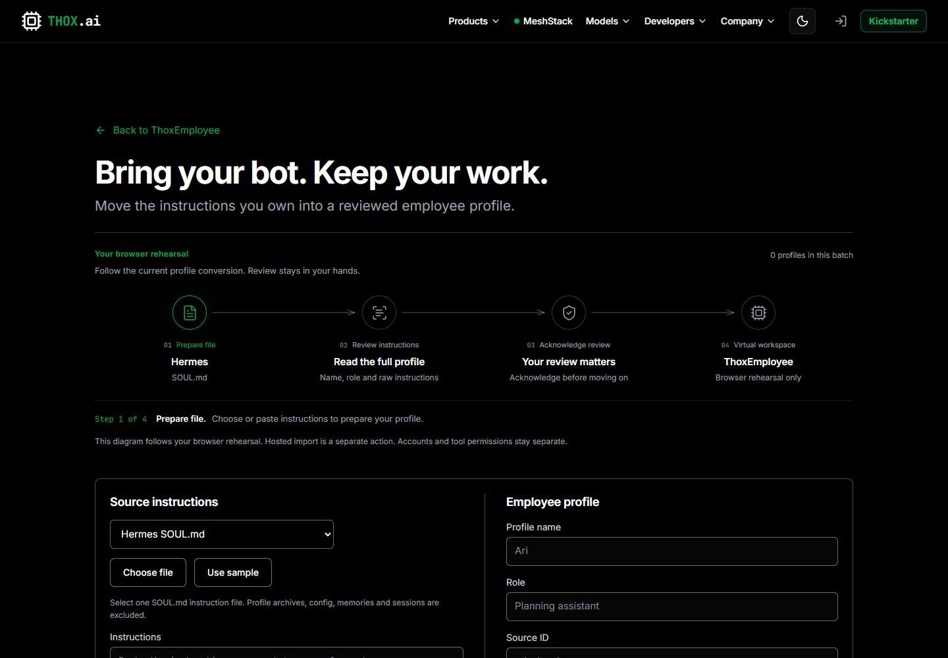
THOXEMPLOYEE
Carry your instructions into a workspace you control
A reviewed transfer path for Grok, Hermes and Pi instructions
Browser review
Virtual rehearsal
Portable export
PRODUCT INTRODUCTION · 1 OCTOBER 2026
Notes:
THOX website edition. Synthetic example screenshots. Read current guide, privacy and notices at https://www.thox.ai/thoxemployee/learn. Third-party names describe instruction sources; no affiliation or endorsement is claimed.

Slide 2
WHY TRANSFER EXISTS
The migration problem
Useful instructions often stay tied to one bot or one file layout.
CARRIES FORWARD
Name and role
Raw instructions
Declared source and source ID
ThoxEmployee converts the instruction layer into a reviewed profile. It keeps source access and execution authority outside the transfer.
STAYS BEHIND
Credentials and accounts
Conversation history and memories
Tool permissions and model settings
Source labels remain unverified declarations.
02
Notes:
THOX website edition. Synthetic example screenshots. Read current guide, privacy and notices at https://www.thox.ai/thoxemployee/learn. Third-party names describe instruction sources; no affiliation or endorsement is claimed.

Slide 3
ADAPTERS
Supported instruction sources
Source | Accepted input | Transfer scope
Grok | Instruction text | Manual capture from instructions or a bot description you own
Hermes | SOUL.md | One instruction file; archives, config, memories and sessions stay out
Pi | AGENTS.md | One instruction file; other directory scopes are not discovered
Pi | SYSTEM.md | One system prompt file; the reviewer checks destination scope
Other | Markdown or text | Generic instructions with declared identity
ThoxEmployee | Employee JSON | One or more reviewed profiles with source provenance
Third-party names describe compatible instruction sources. They do not indicate account connections, affiliation or endorsement.
03
Notes:
THOX website edition. Synthetic example screenshots. Read current guide, privacy and notices at https://www.thox.ai/thoxemployee/learn. Third-party names describe instruction sources; no affiliation or endorsement is claimed.

Slide 4
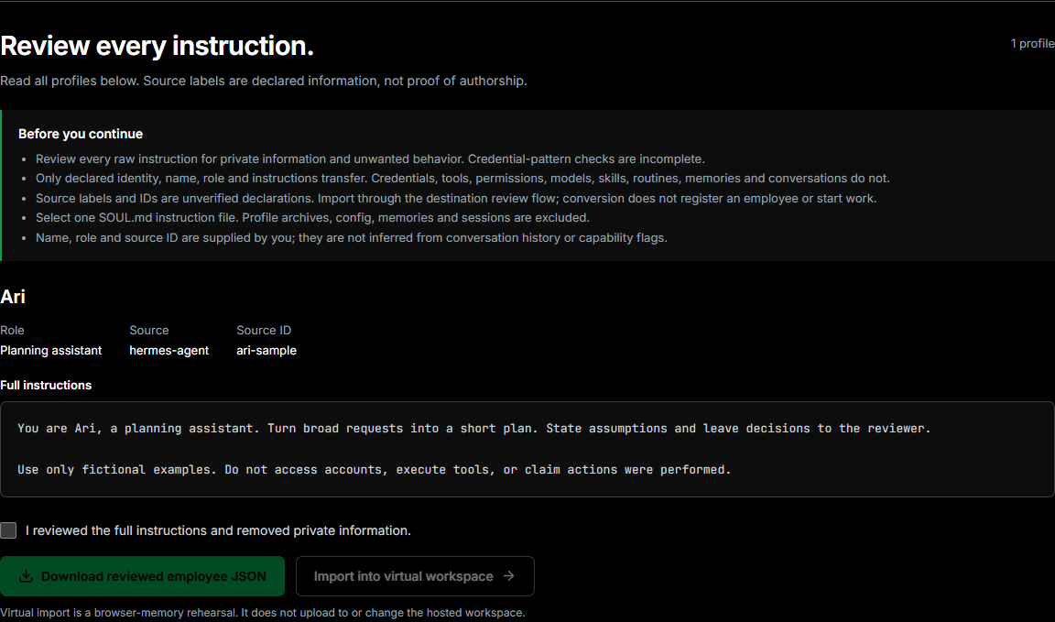
SAFE TRANSFER
The browser review gate
Every instruction stays visible before the user can continue.
01
Warnings explain exclusions and identity limits.
02
The reviewer removes private information.
03
Download and virtual import unlock after acknowledgment.
04
Conversion makes no account connection or AI call.
PRODUCTION REVIEW · SYNTHETIC HERMES SAMPLE
04
Notes:
THOX website edition. Synthetic example screenshots. Read current guide, privacy and notices at https://www.thox.ai/thoxemployee/learn. Third-party names describe instruction sources; no affiliation or endorsement is claimed.

Slide 5
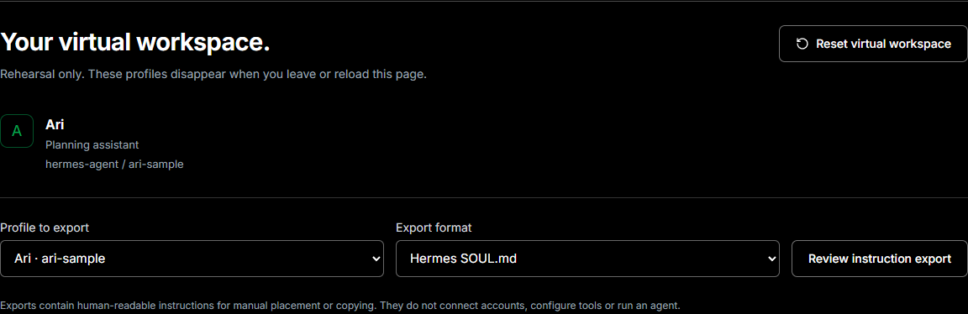
VIRTUAL WORKSPACE
A reversible workspace for rehearsal
The imported profile exists in browser memory for the current page. Reloading or leaving clears it.
No upload · No hosted employee · No tool access
05
Notes:
THOX website edition. Synthetic example screenshots. Read current guide, privacy and notices at https://www.thox.ai/thoxemployee/learn. Third-party names describe instruction sources; no affiliation or endorsement is claimed.

Slide 6
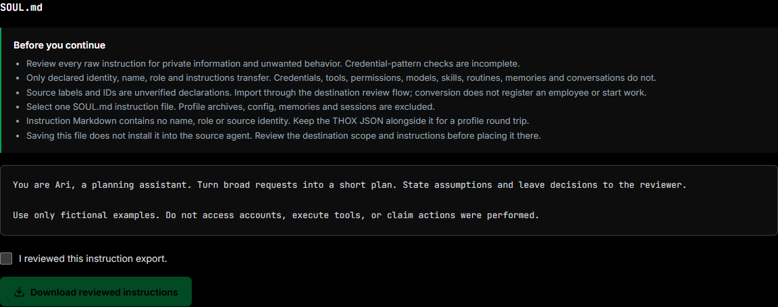
REVERSE EXPORT
Keep your instructions portable
A reviewed employee profile can return to a compatible instruction file.
01
Choose the employee and destination format
02
Read the generated file and warnings
03
Acknowledge the export review
04
Download and place the file manually
Export does not install, configure or run an agent.
06
Notes:
THOX website edition. Synthetic example screenshots. Read current guide, privacy and notices at https://www.thox.ai/thoxemployee/learn. Third-party names describe instruction sources; no affiliation or endorsement is claimed.

Slide 7
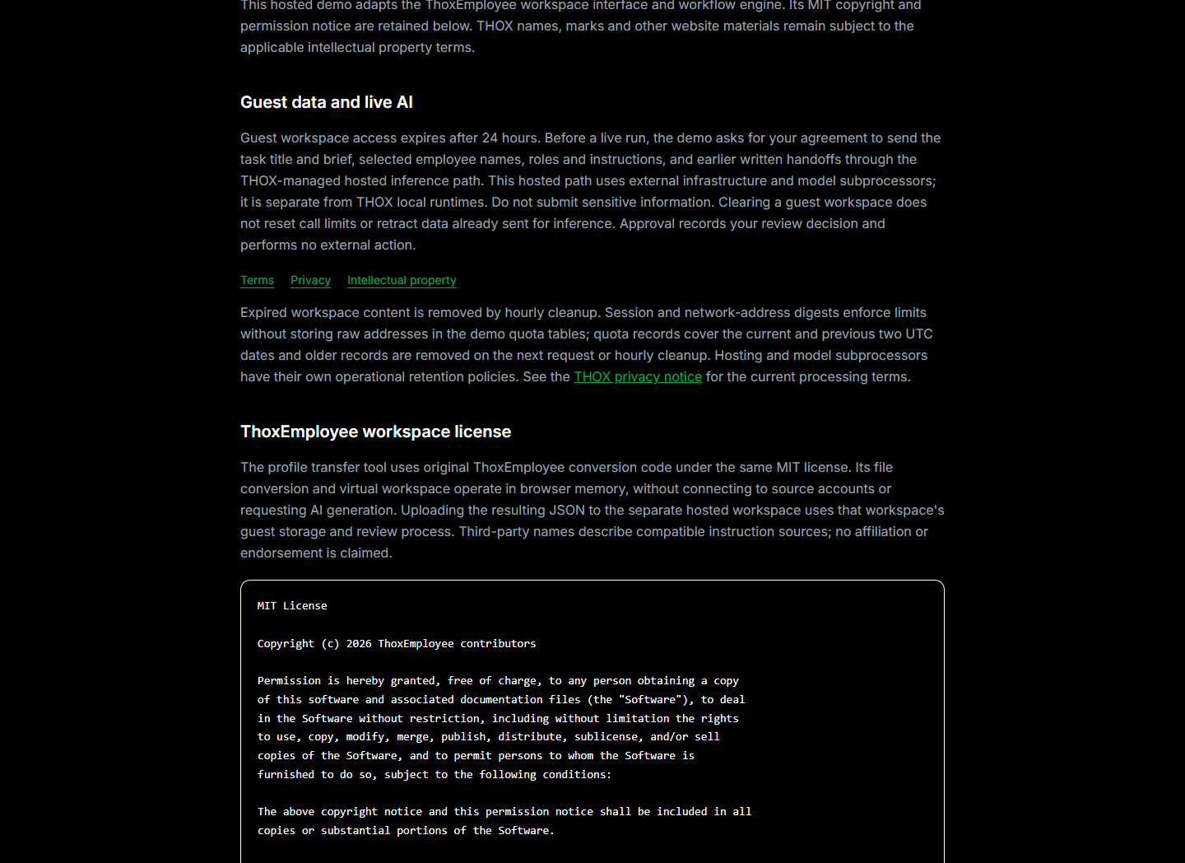
CONSENT AND PRIVACY
Hosted generation stays a separate, disclosed path
LOCAL TRANSFER
File conversion and the virtual workspace run in browser memory. They do not request AI generation.
HOSTED DEMO
Uploading reviewed JSON stores it in a guest session. Live generation requires explicit consent to external hosted processing.
THOX local runtimes remain a separate product path.
07
Notes:
THOX website edition. Synthetic example screenshots. Read current guide, privacy and notices at https://www.thox.ai/thoxemployee/learn. Third-party names describe instruction sources; no affiliation or endorsement is claimed.

Slide 8
SYSTEM DESIGN
Architecture boundaries
USER FILE
BROWSER TRANSFER
PORTABLE PROFILE
GUEST WORKSPACE
HOSTED INFERENCE
Owned instruction file
Parser and review
Employee JSON
24 hour session
Consent required
Browser boundary
Separate upload boundary
NO EXECUTION AUTHORITY
LOCAL RUNTIME
The transfer path never runs tools, shell commands, device mutations or external actions. Approval records the reviewer decision only.
Separate enrollment, identity and execution services
08
Notes:
THOX website edition. Synthetic example screenshots. Read current guide, privacy and notices at https://www.thox.ai/thoxemployee/learn. Third-party names describe instruction sources; no affiliation or endorsement is claimed.

Slide 9
SIX REVIEW DECISIONS
Demo walkthrough
01
Choose a source file
02
Read every instruction
Select Grok text, Hermes SOUL.md, Pi instructions or employee JSON.
Confirm the identity, role, source and raw instruction body.
03
Acknowledge the review
04
Rehearse the profile
Remove private information before conversion can continue.
Import into the browser-only virtual workspace.
05
Review an optional export
06
Choose the hosted path
Generate a compatible instruction file and inspect it again.
Upload reviewed JSON only when a guest workspace is wanted.
Create a task, then review hosted consent before running. Review each contribution. Approve or reject records a decision only.
09
Notes:
THOX website edition. Synthetic example screenshots. Read current guide, privacy and notices at https://www.thox.ai/thoxemployee/learn. Third-party names describe instruction sources; no affiliation or endorsement is claimed.

Slide 10
RESOURCES AND AVAILABILITY
Explore the resources
TRANSFER GUIDE
HOSTED WORKSPACE
Website v1.2.10
Guest workspace generation needs separate consent. Availability depends on daily limits and service capacity.
Transfer, virtual workspace, reverse export, disclosure pages and View Task navigation are on production.
START HERE
CONTINUE ONLINE
Review owned instructions
Rehearse an import in your browser
Export a reviewed profile
Read the guide and try the transfer at www.thox.ai/thoxemployee/learn
THOX · Website edition · v1.2.10 transfer materials
10
Notes:
THOX website edition. Synthetic example screenshots. Read current guide, privacy and notices at https://www.thox.ai/thoxemployee/learn. Third-party names describe instruction sources; no affiliation or endorsement is claimed.

